Slide 1

FY25 Budget Approval Meeting

Slide 2
Norms
This is a meeting of the GO Team. Only members of the team may participate in the discussion. Any members of the public present are here to quietly observe.
We will follow the agenda as noticed to the public and stay on task.
We invite and welcome contributions of every member and listen to each other.
We will respect all ideas and assume good intentions.

Slide 3
Agenda
Action Items
  Approval of Agenda
  Approval of Previous Minutes
  Budget Approval (after final presentation/review and discussion)
Discussion Items
  Presentation of the final budget
  Security Grant Survey
Information Items
  Principal’s Report
Announcements
  Complete EOY GO Team Surveys

Slide 4

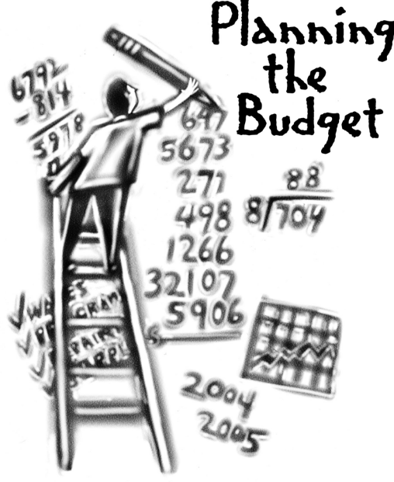
Overview of FY ‘25 GO Team Budget Process
Step 1 Review and Update Strategic Plan and Rank Strategic Priorities
By end of Fall Semester
Step 6 Principals: HR Staffing Conferences Begin
Late February – Early March
Step 3 GO Team Initial Budget Session: Allocation
January 17– early February
Step 7 GO Team Final Budget Approval Meeting
Budgets Approved by March 15
Step 5
GO Team Feedback Session: Draft Budget Presented & Discussed
February – multiple meetings, if necessary
Step 4 Principals: Associate Supt. Discussions and Review
February (supports needed, specific challenges, coaching)
Step 2 Principals: Workshop FY 25 Budget
January 17, 2024
GO Teams are encouraged to have ongoing conversations throughout the year about the school’s budget.

Slide 5
Budget Approval Meeting
What
During this meeting GO Teams will review the budget, which should be updated based on feedback from the staffing conference, Associate Superintendents, and key leaders. After review, GO Teams will need to take action (i.e., vote) on the FY25 Budget.
Why
Principals will present the final budget recommendations for GO Team approval.
When
All approval meetings must be held after staffing conferences. Budgets must be approved by March 15th.

Slide 6
Budget Review

Slide 7

FY25 Budget Parameters
FY25 School Priorities | Rationale
1. Create a culture of high expectations for academic scholarship, civic responsibility, and service for students, staff, and families. | A culture of high expectations will support improved student outcomes
2. Prepare and develop all teachers to be knowledgeable in their content area. | Building teacher capacity in their content area fosters the opportunity for students to engage in rigorous and relevant learning experiences.
3. Improve students’ mastery of core content knowledge (ELA, Math, Science, Social Studies. | Increasing student achievement will ensure students are prepared for high school and post secondary options.
Notes:
Review the priorities that the GO Team has developed and the rationale for these priorities. Feel free to copy this slide if you have more than 3 priorities to account for.

Slide 8
FY25 Budget Parameters
FY25 School Priorities | Rationale
4. Close the student achievement gap with general education and students with disabilities. | A focus on subgroups ensures all students are a part of the instructional planning process.
5. Implement STEAM-enriched curriculum to drive interdisciplinary and project-based teaching and learning approaches. | Interdisciplinary teaching provides opportunities for students to develop a deeper understanding of content.
6. Prepare all students to have the essential life skills to be self-aware, collaborative, and accepting of diversity. | An intentional focus on developing social skills is critical to middle school learns.
7. Ensure systems and resources are aligned with school priorities | Ensuring systems and recourses are aligned with priorities optimizes human and financial capital.
Notes:
Review the priorities that the GO Team has developed and the rationale for these priorities.

Slide 9
Descriptions of Strategic Plan
Breakout Categories
Priorities: FY25 funding priorities from the school’s strategic plan, ranked by the order of importance.
APS Five Focus Area: What part of the APS Five is the priority aligned to?
Strategies: Lays out specific objectives for school’s improvement.
Request: “The Ask” What needs to be funded in order to support the strategy?
Amount: What is the cost associated with the Request?

Slide 10
FY25 Strategic Plan Break-out
Priorities | APS FIVE Focus Area | Strategies | Requests | Amount
1. Create a culture of high expectations for academic scholarship, civic responsibility, and service for students, staff, and families. | Building a Culture of Student Support | 1. Common structures and strategies 2. Beliefs and mindsets 3. Scholar expectations 4. Faculty/Staff Expectations 5. Implement a schoolwide behavior plan | Supplies and Student Incentives Counselors (3) | $68, 600 $397, 016
2. Prepare and develop all teachers to be knowledgeable in their content area. | Equipping & Empowering Leaders and Staff | 1.Provide targeted professional learning opportunities focused on the implementation of standards. 2.Implement intentional vertical and horizontal alignment collaboration through the school and cluster. 3.Provide targeted professional learning regarding standard-based instruction opportunities focused on Mathematics and Reading through our partnership. 4.Increase reading, math, and science endorsements and certifications. 5.Leverage professional references of applicants. 6.Look at previous student performance data, if applicable. | Instructional Coaches (3) Employee PL Travel Professional Development | $391,016 $79,000 $23,000
Notes:
For the next few slides, I will show you how I have allocated the budget to support our strategic priorities.
Based on our strategic priorities and funds we received, here is a break-out of the priorities, which focus area it addresses, the strategies that will be implemented, the purchase request, which funding source was used and the amount.

Slide 11
FY25 Strategic Plan Break-out
Priorities | APS FIVE Focus Area | Strategies | Requests | Amount
3. Improve students’ mastery of core content knowledge (ELA, Math, Science, Social Studies. | Fostering Academic Excellence for All | 1A. Implement standards-based strategies. 1B. Build teacher capacity around instructional best practices through collaborative planning and the coaching cycle. 1C. Provide remediation and acceleration as indicated by data. 2A. Implement data talks to increase math and reading fluency. 2B. Use flexible learning days to remediate/ accelerate skills based on grade-level data to guide instructional practices. 2C. Implement guided reading and close reading to improve comprehension. 3A. Provide targeted professional learning opportunities focused on implementing standards and STEAM. 3B. Implement integrated, project and problem-based learning projects. 3C. Integrate technology throughout the curriculum. 4A. Implement Social Emotional Learning (SEL). 4B. Implement rigorous and real-world interdisciplinary projects and units. 4C. Execute a plan to increase the speaking, listening, and viewing skills of all students at grade level. | Core Content Teachers (8 Interdisciplinary Teams) Web-based Subscriptions and Licenses | $3,383182 $40,963
4. Close the student achievement gap with general education and students with disabilities. | Fostering Academic Excellence for All |  | Engagement Specialist SST Intervention Specialist | $124, 059 $124, 059
5. Implement STEAM-enriched curriculum to drive interdisciplinary and project-based teaching and learning approaches. | Fostering Academic Excellence for All |  | Signature Instructional Coach Fine Arts Teachers | $125,526 528,621
6. Prepare all students to have the essential life skills to be self-aware, collaborative, and accepting of diversity. | Fostering Academic Excellence for All |  | CTE Teachers Health\PE Teachers School Military Instructor Student Transportation | $211,449 $317,173 $105,724 $62,000
Notes:
For the next few slides, I will show you how I have allocated the budget to support our strategic priorities.
Based on our strategic priorities and funds we received, here is a break-out of the priorities, which focus area it addresses, the strategies that will be implemented, the purchase request, which funding source was used and the amount.

Slide 12
FY25 Strategic Plan Break-out
Priorities | APS FIVE Focus Area | Strategies | Requests | Amount
7. Ensure systems and resources are aligned with school priorities | Creating a System of School Support | 1.Build and align systems and resources to identify and address root causes to promote social and academic growth. 2.Ensure the necessary technology infrastructure and equipment are available. 3.Use the Care Center at John Lewis Invictus Academy to promote healthy living and increase attendance. 4.Use wrap-around services to assist students and their families with emotional, mental, and physiological needs. 5.Utilize the parent liaison to build and strengthen school-home relationships. 6.Design and implement behavior goals for all students to promote positive interaction with adults. | Parent Liaison | $51, 871
Notes:
For the next few slides, I will show you how I have allocated the budget to support our strategic priorities.
Based on our strategic priorities and funds we received, here is a break-out of the priorities, which focus area it addresses, the strategies that will be implemented, the purchase request, which funding source was used and the amount.

Slide 13
Summary of Position Changes to Support the Strategic Plan
CREATED | REMOVED
Social Studies Teachers (8) Current Teachers ELA, Humanities, and SS | Assistant Principal (1)
 | Bookkeeper (1)
 | Counselor (1)
 | Master Teacher Leaders (1.5)
 | Non-Instructional Aide – Cares III (1)
 | Paraprofessionals (2)
 | Social Emotional Learning Coach (1)
 | General Education Teachers (4)
 | Turnaround Behavior Specialist (2)
 | Turnaround Instructional Coach (1)
Summary of Changes
Duties of removed positions will be absorbed by staff who traditionally perform similar duties. During our budget feedback meeting, consideration for class size was discussed. Additional support positions removed to fund additional general education teachers. SST Interventional Specialist will be funded for the 2023 - 2024 During the 2024 – 2025 6th and 7th grade students will return to 4 Core Classes.

Slide 14

Staffing Conference Changes
There were not any changes made to the draft budget we discussed at our last meeting.

Slide 15
Budget by Function (Required)
*Based on Current Allocation of School Budget
Account | Account Description | FTE | Budget | Per Pupil
1000 | Instruction | 77.00 | $ 8,091,355 | $ 11,882
2100 | Pupil Services | 9.75 | $ 833,704 | $ 1,224
2210 | Improvement of Instructional Services | 4.00 | $ 164,526 | $ 242
2213 | Instructional Staff Training | - | $ 48,000 | $ 70
2220 | Educational Media Services | 1.00 | $ 123,029 | $ 181
2400 | School Administration | 8.00 | $ 1,036,587 | $ 1,522
2600 | Maintenance & Operations | 7.00 | $ 531,304 | $ 780
2700 | Transportation | - | $ 62,000 | $ 91
Total |  | 106.75 | $ 10,890,506 | $ 15,992

Slide 16
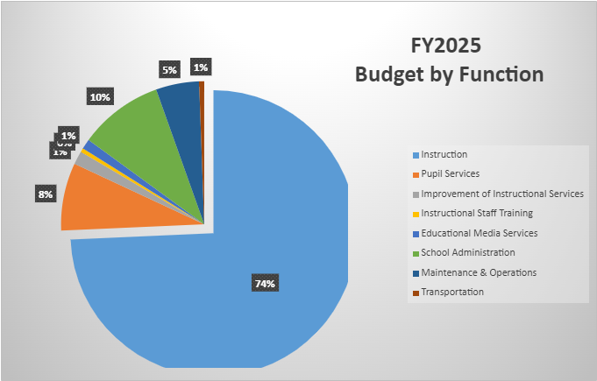
Budget by Function (Required)
*Based on Current Allocation of School Budget

Slide 17
Discussion of reserve and Holdback funds

Slide 18
Plan for FY25 Leveling Reserve
$116,024
Priorities | APS FIVE Focus Area | Strategies | Requests | Amount
Increase level of rigor and relevance (example- please remove) | Fostering Academic Excellence for All (example- please remove) | Implementation of guided reading training for all staff (example- please remove) | Purchase an additional Teacher (example- please remove) | $84, 134 (example- please remove)
Notes:
For the next few slides, I will show you how I have allocated the budget to support our strategic priorities.
Based on our strategic priorities and funds we received, here is a break-out of the priorities, which focus area it addresses, the strategies that will be implemented, the purchase request, which funding source was used and the amount.

Slide 19
Plan for FY25 Title I Holdback $69,741
Priorities | APS FIVE Focus Area | Strategies | Requests | Amount
Increase level of rigor and relevance (example- please remove) | Fostering Academic Excellence for All (example- please remove) | Implementation of guided reading training for all staff (example- please remove) | Purchase an additional Teacher (example- please remove) | $84, 134 (example- please remove)
Notes:
For the next few slides, I will show you how I have allocated the budget to support our strategic priorities.
Based on our strategic priorities and funds we received, here is a break-out of the priorities, which focus area it addresses, the strategies that will be implemented, the purchase request, which funding source was used and the amount.

Slide 20
Questions for the GO Team to Consider and Discuss
Are our school’s priorities (from your strategic plan) reflected in this budget?
Are new positions and/or resources included in the budget to address our major priorities?
Do we know (as a team) the plan to support implementation of these priorities beyond the budget (ex. What strategies will be implemented)?
What tradeoffs are being made in order to support these priorities?
How are district and cluster priorities reflected in our budget?
Cluster priorities- what staff, materials, etc. are dedicated to supporting our cluster’s priorities?
Signature programs- what staff, materials, etc. are dedicated to supporting our signature program?
Are there positions our school will share with another school, e.g. nurse, counselor?
Notes:
CHAIR - Our final task for today! Here are questions that we need to consider to ensure we have a good working draft budget. Let’s walk through them together.

Slide 21

Questions?

Slide 22
The GO Team needs to TAKE ACTION (vote) on the presented budget. After the motion and a second, the GO Team may have additional discussion. Once discussion is concluded, the GO Team will vote.
Action on the Budget

Slide 23

Security Grant
Survey

Slide 24
Announcements

Slide 25
Provide Your Feedback on the Final APS Student Calendar Survey
Atlanta Public Schools has used widespread community engagement to create two calendar options for the following school years: SY 25-26, SY 26-27, and SY 27-28.
Your feedback through this survey is valuable and will be another important piece of information that the Superintendent and the APS School Board of Education will use to make a final decision about our future school calendars.
HOW: Scan the QR code or click the link for a quick survey.
WHO: All stakeholders, including students, staff, families,
and community members.
WHEN: Open from Mon, February 19th to Fri, March 15th
https://survey.co1.qualtrics.com/jfe/form/SV_0VrymDxIIaygE9E
To learn more about the APS Student Calendar development process, visit https://www.atlantapublicschools.us/Page/71713

Slide 26
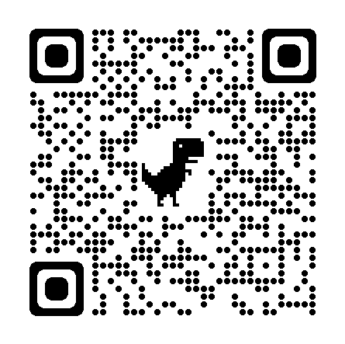
Comparta su opinión en la encuesta final del Calendario Escolar de APS
Basándose en la participación de la comunidad en general, Atlanta Public Schools ha elaborado dos opciones de calendario para los próximos años escolares: 2025-2026, 2026-2027 y 2027-2028.
Su opinión en esta encuesta cuenta y será un factor más que la Superintendente y la Junta de Educación de APS considerarán al momento de tomar la decisión final sobre los calendarios escolares futuros.
CÓMO: Escanee el Código QR o haga clic en el enlace para completar una breve
encuesta.
QUIÉN: Todas las partes interesadas, incluidos alumnos, personal escolar,
familias y miembros de la comunidad.
CUÁNDO: abierta desde el lunes 19 de febrero hasta el viernes
15 de marzo
https://survey.co1.qualtrics.com/jfe/form/SV_cAqsxuT3U5nNu0m?Q_lang=ES
Para más información sobre el proceso de desarrollo del Calendario Escolar para Estudiantes de APS, visite: https://www.atlantapublicschools.us/Page/71713

Slide 27
GO Team members remember to:
  Complete your required trainings
    Orientation
    Ethics
    Budget
  Complete the end of year surveys (check your email for the links)
    GO Team Self-Assessment
    Principal Feedback

Slide 28
Questions?

Slide 29

Thank you

